Slide 1
Car Resale Price Prediction

Slide 2
Data Pre processing
Loading of Pickle file
Training and testing the model
Pickle File
User
Taking Inputs
Choosing Best R2 Score model
Display Output
Implementation of Model
User Interface

Slide 3
Start
Data Processing
(ML Models)
Data Collection
Random Forest
XGBoost Regression
AdaBoost Regression
Data Cleaning
Best R2 Score Model
Data Transformation
Pickle File

Slide 4
Dataset
Data will be extracted from website, Instead of downloading datasets from online sources
Model will be trained on live market value.
Sources: cars24

Slide 5
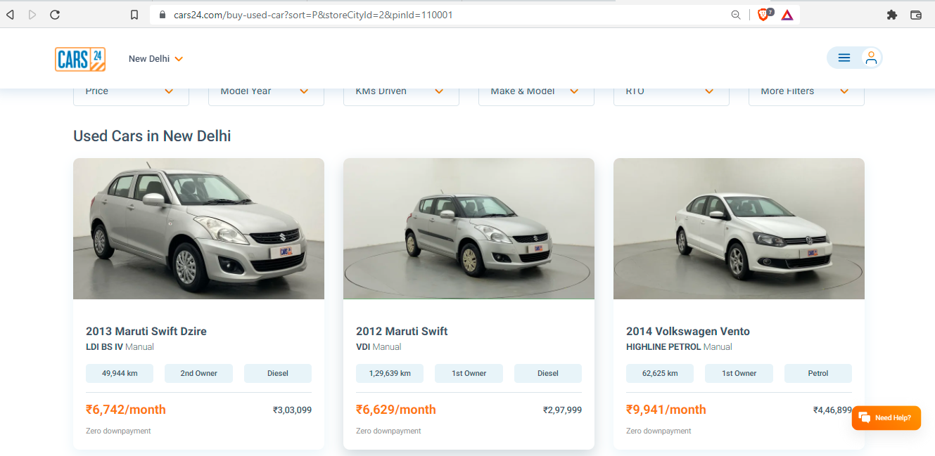

Slide 6
<div class="col-4">
<div class="_1l4fi">
<div class="_15rKe">
<div class="_1jpRU">
<h2 class="_3FpCg">2012 Maruti Swift</h2>
<p class="cvakB">VDI
<span>Manual</span></p></div></div>
<ul class="bVR0c"><li>1,29,639 km</li>
<li>1st Owner</li>
<li>Diesel</li>
</ul><div class="_19zc5"><div class="_2HFRN">
<strong>₹6,629/month</strong></div>
<div class="_7udZZ"><span>₹2,97,999</span></div></div>
<div class="JvSRy">
<span class="_3X7mV _2H07I">Zero downpayment</span></div>
</div></a></div>

Slide 7
Modules Used for Data Extraction
Selenium Python
To get the html data
Html parser
To parse the data and get values needed
Python Pandas
To Store the data in csv file ( Structured format )

Slide 8
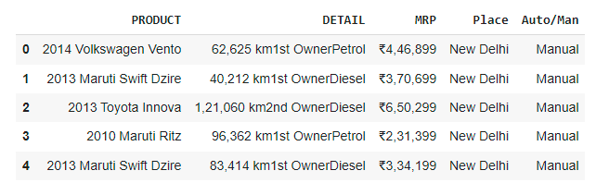
Source
Selenium
HTML Parser
Product
Features
Auto/Man
place
Price

Slide 9
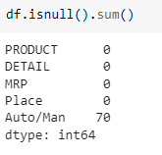
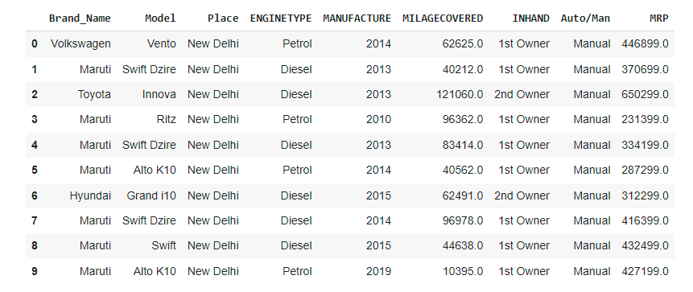
Data Cleaning

Slide 10
Start
Training and testing the model
Data Collection
Random Forest
XGBoost Regression
AdaBoost Regression
Data Cleaning
Best R2 Score Model
Data Transformation
Pickle File

Slide 11
ML Models
Random Forest Regression
XGBoost Regression
AdaBoost Regression

Slide 12
Why only these 3?
Because they are extensions of Decision Tree Algorithm
Why Decision Tree Algorithm?
A significant advantage of a decision tree is that it forces the consideration of all possible outcomes of a decision and traces each path to a conclusion.

Slide 13
Compared to other algorithms decision trees requires less effort for data preparation during pre-processing.
A decision tree does not require normalization of data.
A decision tree does not require scaling of data as well.
Missing values in the data also do NOT affect the process of building a decision tree to any considerable extent.

Slide 14
User Interface
Front End: KivyMD Python…..why?
Because it is a graphical interface tool which can be implemented both on android as well as desktop.
Back End: Python ( No database )
Because already the model has been deployed, the only thing the backend has to do is the selection of pickle file and predicting the price with the given features

